Slide 1
Multivariable Constrained Optimization
Dushyant Pratap Singh
244103101

Slide 2
Flowchart
start
Read number of variables(n),number of constraints(m), and bounds on the variables from the input file
Pass the variables to the bracket operator penalty function
Performing Marquart’s multivariable method and applying unidirectional search by Converting multivariable problem into single variable problem by Bounding phase and secant method
Termination Condition
No
YES
Optimal Solution
end

Slide 3
Bracket Operator Penalty method
This penalty method converts the constrained optimization problem into the unconstrained optimization problem.
It assigns the positive value for all the exterior penalty terms.
It’s first sequence begins with a small penalty parameter R which increases subsequently.
This operator mostly used in handling the inequality constrained.

Slide 4

Marquart’s Method
This method is one of the gradient Based Method.
It is a combination of Cauchy’s steepest descent method and Newton’s method.
Search direction is calculated in this method as follows
For large value of λ, this method is similar to Cauchy’s steepest descent method.
For smaller value of λ, this method is similar to Newton’s method.

Slide 5
PROBLEM 1
Initial Guess (x1,x2) | Optimal Point (x1*,x2*) | Optimal Value f(x*) | Number of Sequence | Function evaluations
(15.364666, 0.653951) | (6.432810, -4.877961) | -14260.718809 | 6 | 2867
(15.369366, 1.838435) | (6.432810, -4.877961) | -14260.718809 | 6 | 2807
(15.480453, 2.456130) | (6.432810, -4.877961) | -14260.718809 | 6 | 2727
(13.886135,3.227027) | (-4.824556, 2.897491) | 38549.656399 | 6 | 1446
(15.475539, 1.271645) | (6.432810, -4.877961) | -14260.718809 | 6 | 1266
(15.469131, 1.463179) | (12.220095, 11.985096) | 197.748714 | 6 | 2467
(16.018159, 2.055361) | (6.432810, -4.877961) | -14260.718809 | 6 | 2767
(16.016236, 2.119205) | (-3.617141, 9.870346) | 4333.073279 | 6 | 2487
(16.014100, 2.183050) | (6.432810, -4.877961) | -14260.718809 | 6 | 2867
(16.010681, 3.622791) | (9.631354, 13.865474) | 5868.346518 | 6 | 1266

Slide 6
Best | Worst | Mean | Median | Standard Deviation
-14260.718809 | 38549.656399 | -3661.548794 | -14260.718809 | 17079.77146

Slide 9
Conclusion and Observation of Problem 1
After executing the problem 1 code for 10 different initial guesses. A same optimal function value -14260.718809
is obtained at the same optimal point x* (6.432810,-4.877961)
This results of problem are not coming as expected.
Hassian matrix is coming out to be negative definite, which only guarantees local maximum or saddle point, not a minima.

Slide 10
PROBLEM 2
Initial Point (x1,x2) | Optimal Point (x1*,x2*) | Optimal Value F(x*) | Sequence | Function evaluations
(0.108036, 9.451888) | (1.226961, 4.243160) | -0.095977 | 5 | 1286
(8.800012, 2.610553) | (1.998661, 4.998383) | 0.000000 | 4 | 1548
(8.806726, 5.571764) | (1.999073, 4.998842) | 0.000000 | 4 | 1508
(8.819849, 8.213752) | (1.988981, 4.450179) | 0.000252 | 3 | 674
(8.823817, 1.333964) | (1.522156, 3.487490) | 0.000011 | 3 | 1310
(8.826868, 1.174657) | (1.999122, 4.999099) | 0.000000 | 4 | 1468
(8.836634, 3.976257) | (1.999125, 4.999102) | 0.000000 | 5 | 1308
(8.842738, 3.657033) | (1.508583, 3.545577) | -0.000003 | 5 | 1568
(8.849757, 6.618244) | (1.999073, 4.998841) | 0.000000 | 5 | 1428
(8.853725, 9.739067) | (1.490697, 4.678107) | 0.000007 | 5 | 1508

Slide 11
Best | Worst | Mean | Median | Standard Deviation
-0.095977 | 0.000252 | -0.000957 | 0.000000 | 0.03036

Slide 14
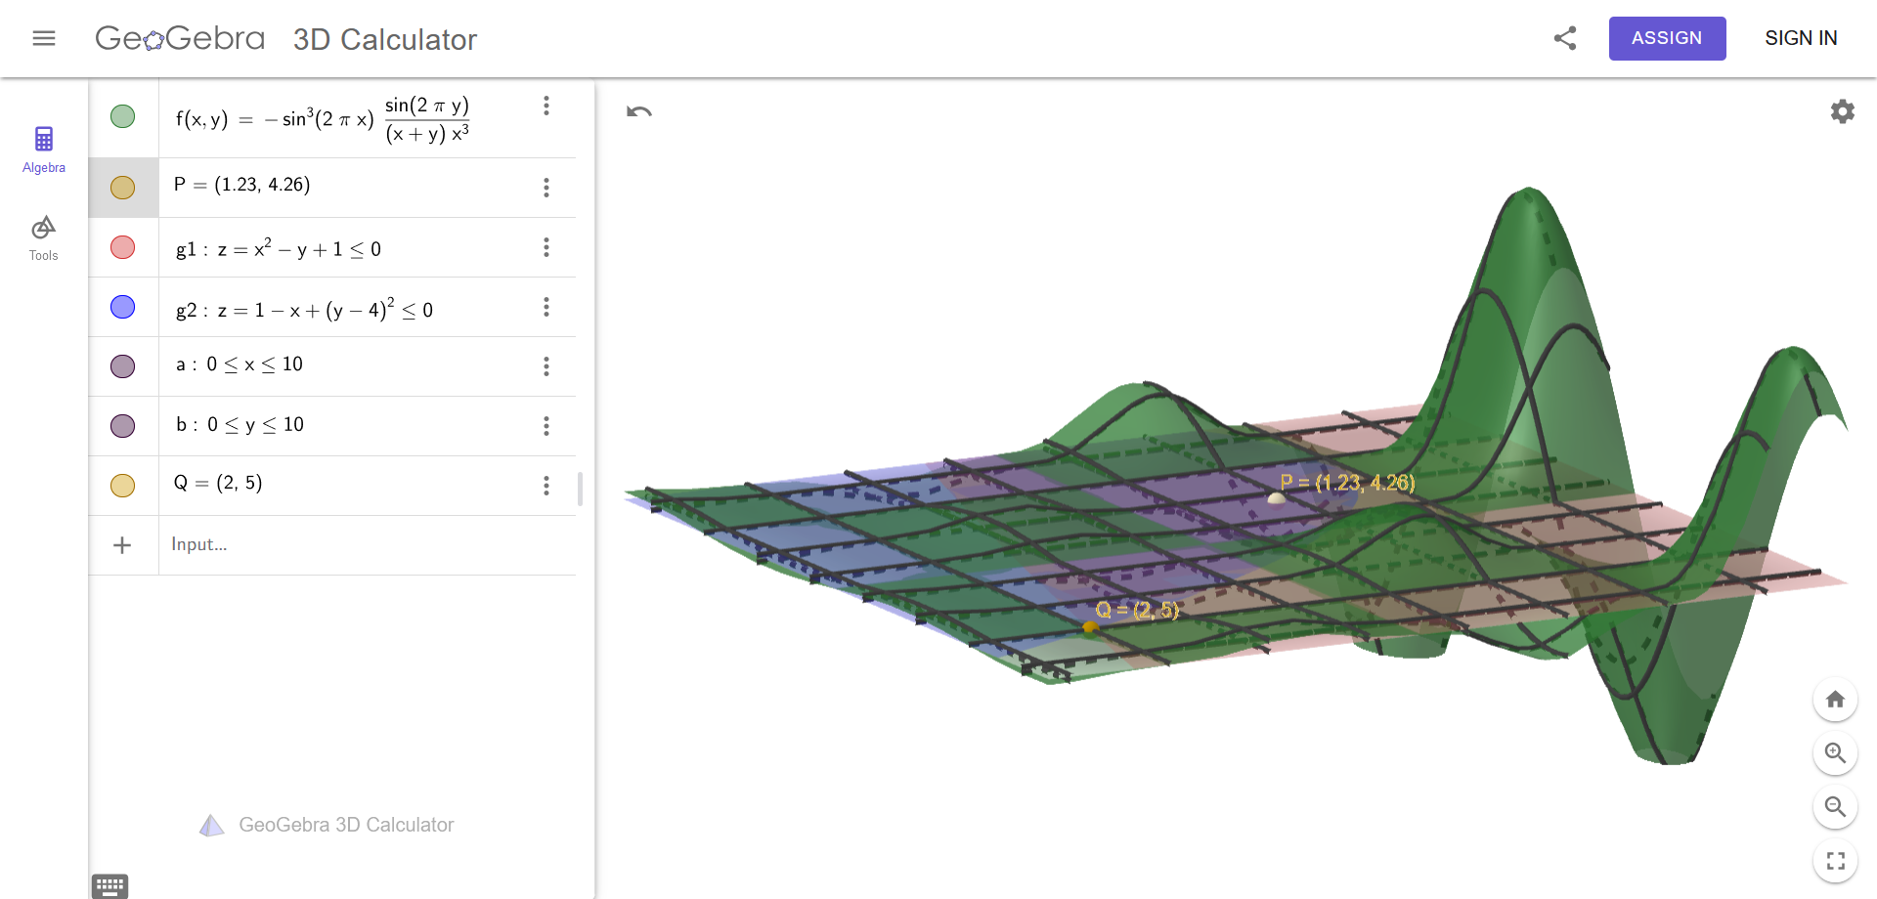

Slide 15
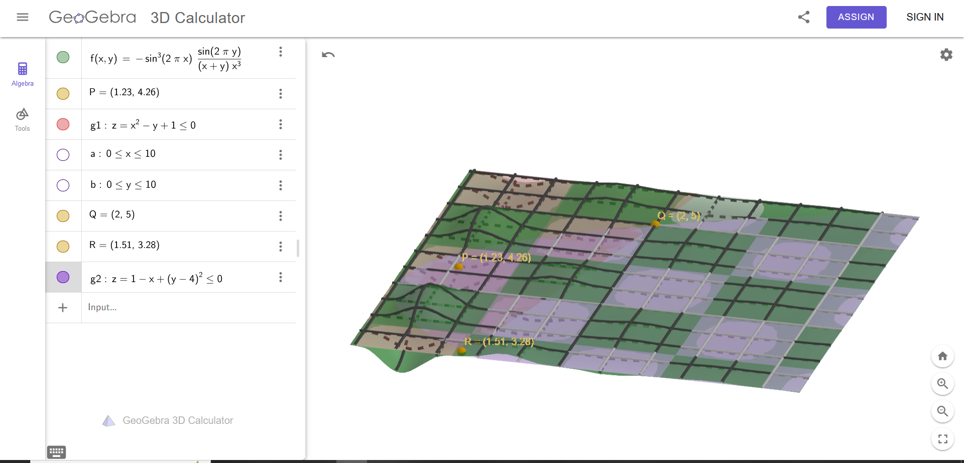

Slide 16
Observation and Conclusion for Problem 2
After executing the problem 2 code for 10 different initial guesses, we are getting the approximately the same optimal function value 0.0000000 but with different optimal points.
As the given function is sinusoidal function, it will have many local minima’s. So most of the time the code gets converged to one of the local minima point that it is (1.99,4.99)

Slide 17
PROBLEM 3
Initial Point (x1,x2,x3,x4, x5,x6,x7,x8) | Optimal Point (x1*,x2*,x3*,x4*, x5*,x6*,x7*,x8*) | Optimal Value F(x*) | Sequence | Function evaluations
(6093.417158, 8962.034974, 3064.943388, 509.124119, 685.056307, 857.030549, 581.092257, 106.531571) | (-16242148914011.535000, -16242149084706.582000, -16242148515752.902000, -80240.156901, 44422.783453, -26965.696123, -142332.957931, -193256.737848) | -48726446514471.016000 | 5 | 84046
(6231.492050, 8261.360515, 5980.803858, 320.592975, 753.006073, 636.050295, 875.944090, 594.960173) | (-2604514381164.074700, -2604501233157.835900, -2604501243719.117200, 20293.700142, 58114.610910, -23901.436028, -62352.515110, -645038.226115) | -7813516858041.027300 | 6 | 68615

Slide 18
PROBLEM 3
Initial Point (x1,x2,x3,x4, x5,x6,x7,x8) | Optimal Point (x1*,x2*,x3*,x4*, x5*,x6*,x7*,x8*) | Optimal Value F(x*) | Sequence | Function evaluations
(1768.379772, 3122.898038, 8762.077700, 128.254952, 574.868313, 162.063662, 293.400983, 673.514817) | -4954939887780.861300, -4954940387746.099600, -4954940076775.793000, 66649.882979, 58606.929900, -116956.300658, -42521.659987, -1078782.911504) | -14864820352302.754000 | 5 | 48666
(1626.075014, 1014.831996, 4219.916379, 378.753624, 250.437635, 898.513443, 612.453688, 538.884243) | (-5563082088902.931600, -5563082083979.416000, -5563082088880.117200, -673.343452, 39.570671, -404.561663, -952.691050, -874.899038) | -16689246261762.465000 | 5 | 62233

Slide 22
Conclusion and observation for Problem 3
Code is working for 10 different runs but is not converging near to expected values.
The Possible reason for not converging is the linear behavior of the function itself. So the second derivative terms of f(x) would be zero. Hence penalty function P(x) will only participate in hassian calculation.
Here Marquart’s method may not be able to give the correct results. So we need to look forward to a different method that does not involve the hessian matrix.
Direct search method might be useful to find the optimal solution to such types of linear objective function.

Slide 23
Conclusion
In this project we implement c programming for solving the single variable as well as multivariable , constrained as well as unconstrained type of problems.
At larger value of ‘R’, Marquart’s method converges in less number of iterations.
For the sequence with larger ‘R’ value, the function evaluations are also less.
Every method can not be used for optimizing all types of objective function

